Slide 1
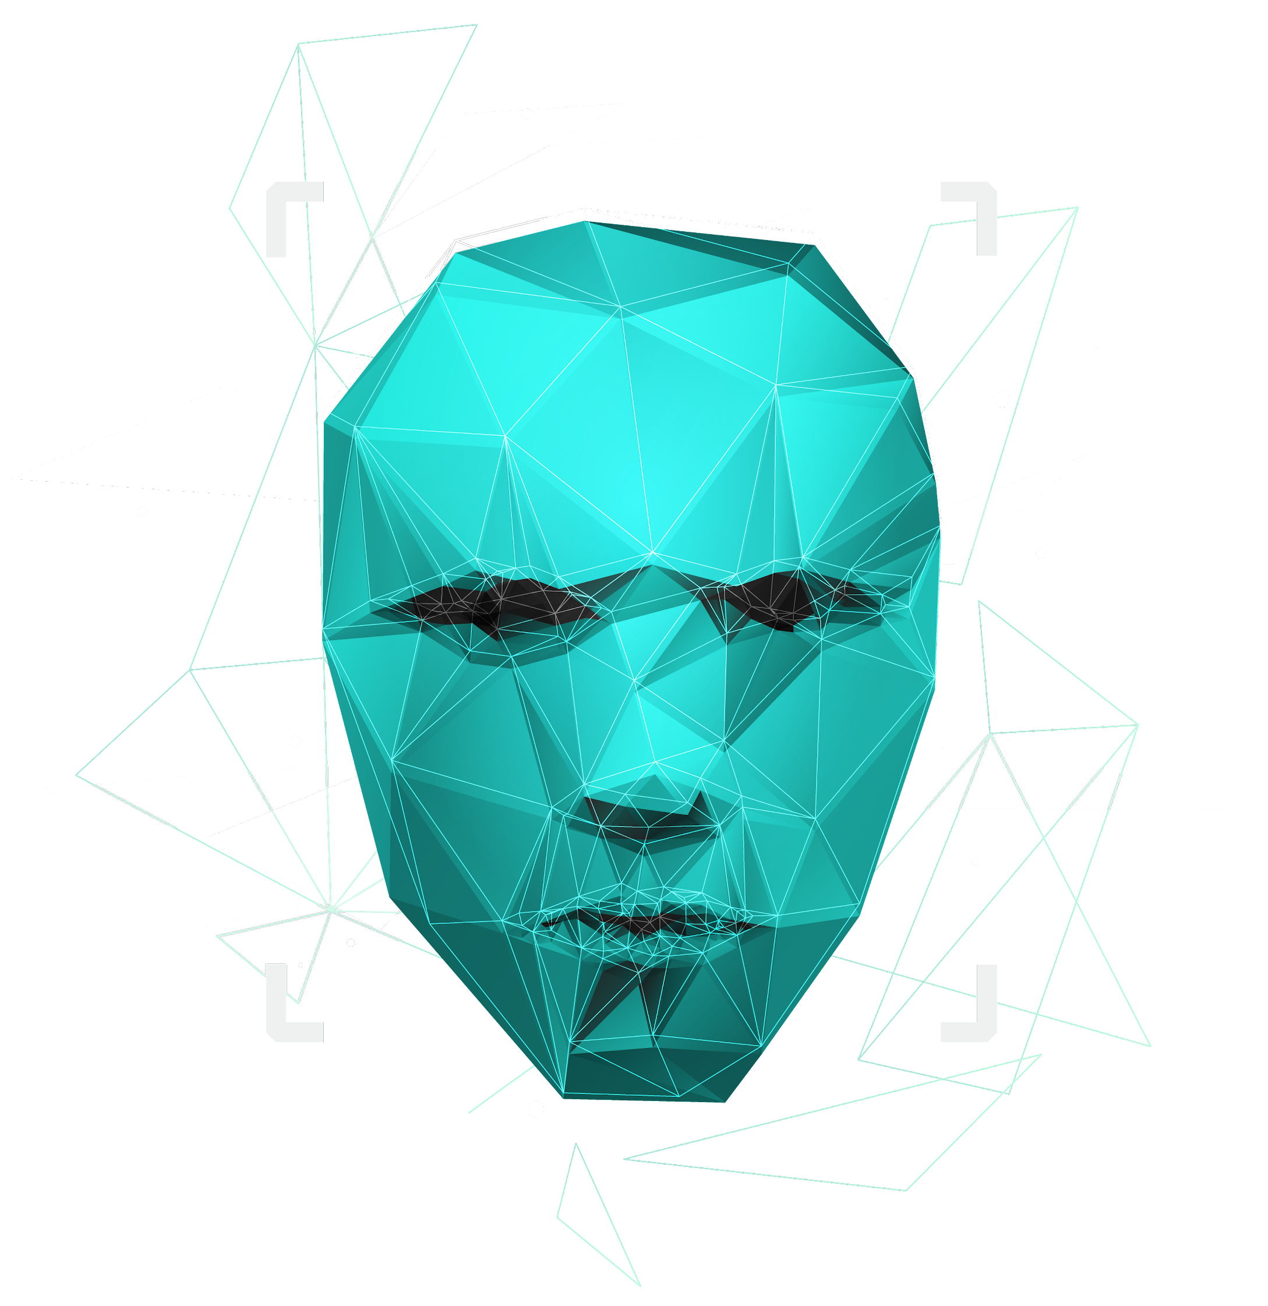
UX Design Lifecycle Activity...
Understand Needs
Chapter 8: Usage Research Data Analysis (Hartson and Pyla, 2019, pp. 143-176)
GDIT 716, Summer 2021
Alicia Segura-Pinto, Alison Wix & Scott Copley

Slide 2
Design
Sample
Analyze
Understand
Evaluate

Slide 3
Synthesizing Notes
Work activity notes can be handwritten or typed into a laptop
Make each work activity note:
ELEMENTAL – primary/basic
BRIEF & CONCISE
COMPLETE
MODULAR – Retaining Context
Additional information to accompany work activity notes
For high rigor, maintain connections to data sources
Preview of sorting work activity notes into categories

Slide 4
Inputs to Stories or Requirements
EXTRACT NOTES that are inputs to user stories or requirements
User Stories and Requirements
A requirement is a small or large-scope statement that is essential to be included in a design
A user story is written as a short narrative description about a capability, function, or feature that is wanted or needed in the product or system
Extracting Inputs to User Stories or Requirements
Keep information from notes about related user work role(s)
+
the reason why the feature is desired

Slide 5
Research Models
Extract notes that are inputs to usage research models
Abstract out the unimportant details to make simplified data representations, or integrate them into corresponding models | Models such as user work roles, task structure, and the basics of the flow model can be developed prior to doing field research | Early project documents (such as proposals or design briefs) and early discussions with the client can provide key information for models | Oftentimes, verification and refinement of modeling to fill gaps can be done after data elicitation

Slide 6
Organize By Category
The remaining work activity notes become inputs to your method for organizing the notes by category
Recording work activity notes in computer-readable form, makes it convenient to print them out for use in making a work activity affinity diagram
Creating a database of user notes can enable a “mail-merge” to format each note into the table cells for later printing

Slide 7
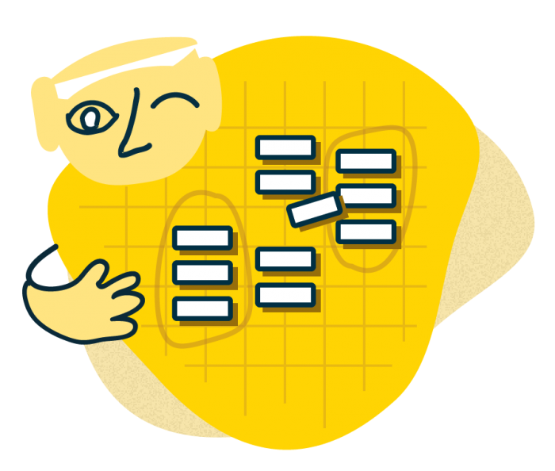
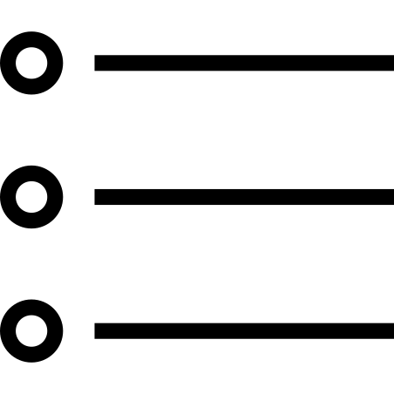
Organize Work Activity Notes
Small & Simple Project
Medium-size & NOT too Complex Project
Large Set & Complex Project and/or High Rigor
HIERARCHICAL BULLET LIST
CARD SORTING TECHNIQUE
WORK ACTIVITY AFFINITY DIAGRAM, OR WAAD

Slide 8
Work Activity Affinity Diagram (WAAD)
For higher rigor in complex projects, construct a WAAD
AFFINITY DIAGRAMS
USE TECHNOLOGY TO SUPPORT WAAD BUILDING
PREPARE YOUR WORK SPACE AND YOUR TEAM
CONTINUE ORGANIZING GROUPS INTO A HIERARCHY
COMPARTMENTALIZE THE WAAD, SEPARATING IT BY USER WORK ROLES
AT THE END, CREATE “HIGHLIGHTS”
THE BOTTOM-UP PROCESS OF WAAD BUILDING
Posting work activity notes
Labels for groups of notes
Growing labels with growing groups
Splitting large groups
As you work

Slide 9
Walkthrough the WAAD to get Feedback
Explain your process and share an appreciation of user work activities and associated issues
Emphasize high-level issues
Highlight the most important points and issues discovered
Create interest with unexpected things learned
Show graphical representations
Sell your usage research process

Slide 10
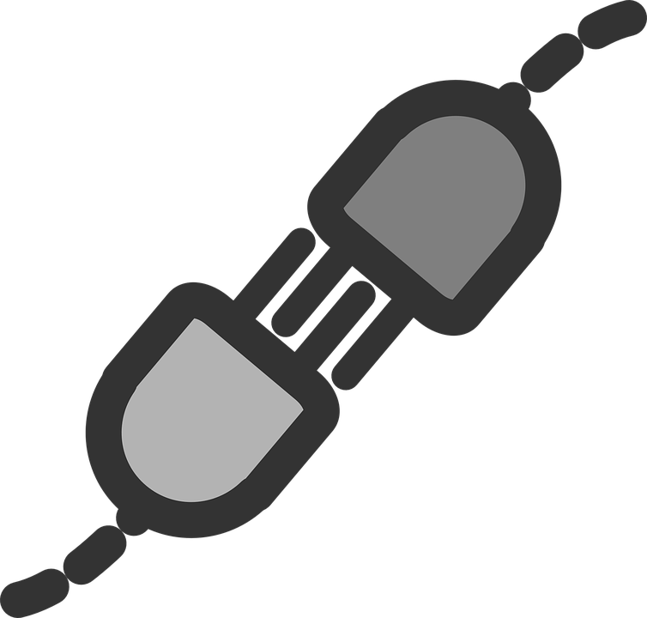
Synthesis
Synthesize the “elephant” that is user work practice and needs
HYBRID MODELS
1
TASK STRUCTURE MODEL
Elephant Skeleton
Putting together INPUTS, FACTS, and OBSERVATIONS
-> Conclusions
-> Understanding of the whole concept
2
TASK SEQUENCE MODEL
Its Skin
CONNECT
3
FLOW MODEL
How the Elephant Moves

Slide 11
References
Hartson, R., & Pyla, P. (2019). The UX Book: Agile UX design for a quality user experience, 2nd ed. Cambridge, MA: Morgan Kaufmann.

Slide 12
Thank You For Your Attention!
Do you have any questions?

