Slide 1
What do you know about
learning theories?
Put your knowledge to the test!
Enter Quiz
Notes:
Add note to this slide

Slide 2
Choose your category:
Educational Philosophy
Behaviorism
Cognitivism
Humanism
Neurolism
exit quiz
All materials adapted from:
Bates, B. (2019). Learning theories simplified (2nd ed.). Sage Publications, Inc.
Notes:
Add note to this slide

Slide 3
Educational Philosophy
Examining the process of finding answers. Philosophers include Socrates, Plato, Aristotle, Descartes, Locke, Rousseau and more.
Back
First Question
Exit
Notes:
Add note to this slide

Slide 4
Educational Philosophy
Which philosopher believed that the life which is
unexamined is not worth living?
Select one:
a) Plato
b) Cher
c) Malcolm X
d) Socrates
back
main menu
exit
next
Notes:
Add note to this slide

Slide 5
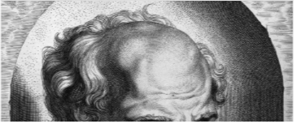
Corrtect!
Back
Next
Main
Exit
Click below to learn more about Socrates!
Notes:
Add note to this slide

Slide 6
Ooops!
Try again...
Back
Next
Main
Exit
Notes:
Add note to this slide

Slide 7
Educational Philosophy
Which philosopher that truth and knowledge is to be found within and that it is in a learner’s nature to behave in the manner that they do?
a) Plato
b) Aristotle
c) Madonna
d) Gucci
back
main menu
exit
next
Notes:
Add note to this slide

Slide 8
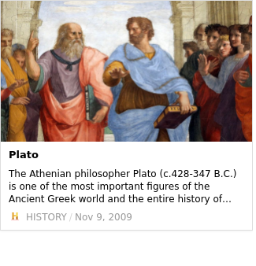
Corrtect!
Back
Next
Main
Exit
Click below to learn more about Plato!
Notes:
Add note to this slide

Slide 9
Ooops!
Try again...
Back
Next
Main
Exit
Notes:
Add note to this slide

Slide 10
Educational Philosophy
Which statement best reflects Aristotle's
self fulfilling prophesy?
Select one:
a) The world is what it is and there is nothing we can do about it.
b) Teachers guide learners to reach their potential through the
wisdom of others.
c) To be or not to be.
d) Do unto others what you would have others do unto you.
back
main menu
exit
next
Notes:
Add note to this slide

Slide 11
Corrtect!
Back
Next
Main
Exit
Click below to watch a video!
Notes:
Add note to this slide

Slide 12
Ooops!
Try again...
Back
Next
Main
Exit
Notes:
Add note to this slide

Slide 13
Educational Philosophy
What is the nature-nurture debate?
Select one:
a) Ringo Star was a natural born drummer.
b) Cats are more loving than dogs.
c) It says the world is what it is and there is nothing we can do about it.
d) It discusses the merits of genetic inheritance and environmental conditioning.
back
main menu
exit
next
Notes:
Add note to this slide

Slide 14
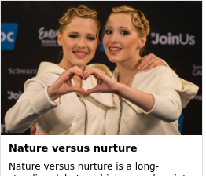
Corrtect!
Back
Next
Main
Exit
Click below to learn more!
Notes:
Add note to this slide

Slide 15
Ooops!
Try again...
Back
Next
Main
Exit
Notes:
Add note to this slide

Slide 16
Behaviorism
Rooted in the late 19th Century, Behaviorism studies how people behave and the emergence of psychology. It is based on stimulus and response, such as a teacher as the central figure in controlling all activities to facilitate changes in behaviors.
Back
First Question
Exit
Notes:
Add note to this slide

Slide 17
Behaviorism
What theorist developed the underpinnings of what would
become known as Connectionism (or Trial and Error)?
Select one:
a) Ivan Pavlov
b) John Watson
c) Edward Thorndike
d) Dikethorn Edwards
back
main menu
exit
next
Notes:
Add note to this slide

Slide 18
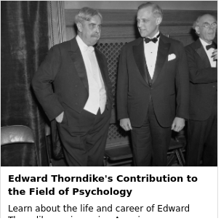
Corrtect!
Back
Next
Main
Exit
Click below to learn more about Thorndike!
Notes:
Add note to this slide

Slide 19
Ooops!
Try again...
Back
Next
Main
Exit
Notes:
Add note to this slide

Slide 20
Behaviorism
What did Burrhus Frederick Skinner's Operant Conditioning - Radical Behaviourism examine:
Select one:
a) Love and hate
b) Positive and negative reinforcement
c) Only negative reinforcement
d) Only positive reinforcement
back
main menu
exit
next
Notes:
Add note to this slide

Slide 21
Corrtect!
Back
Next
Main
Exit
Click below to watch a video!
Notes:
Add note to this slide

Slide 22
Ooops!
Try again...
Back
Next
Main
Exit
Notes:
Add note to this slide

Slide 23
Behaviorism
What theorist developed the underpinnings of what would
become known as Connectionism (or Trial and Error)?
Select one:
a) Ivan Pavlov
b) John Watson
c) Edward Thorndike
d) Dikethorn Edwards
back
main menu
exit
next
Notes:
Add note to this slide

Slide 24
Corrtect!
Back
Next
Main
Exit
Notes:
Add note to this slide

Slide 25
Ooops!
Try again...
Back
Next
Main
Exit
Notes:
Add note to this slide

Slide 26
Behaviorism
What theorist believed that people build cognitive maps of their environment from past experiences, and what was the theory called?
Select one:
a) Edward Tolman - Latent Learning Theory
b) Robert Gagné - Nine Levels of Learning
c) Engelburt Humperdinck - Theory of Sounds
d) Arthur Chickering - Theory of Identity Development
back
main menu
exit
next
Notes:
Add note to this slide

Slide 27
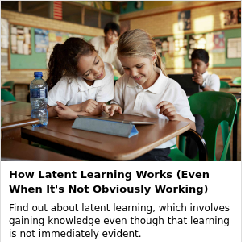
Corrtect!
Back
Next
Main
Exit
Notes:
Add note to this slide

Slide 28
Ooops!
Try again...
Back
Next
Main
Exit
Notes:
Add note to this slide

Slide 29
Cognitivism
Cognitivism is the idea that learning is a process of gathering all of the relevant pieces of information together until they begin to form a complete picture. The analogy with a jigsaw can be drawn in which each piece has little meaning until it is connected with other pieces and a picture begins to emerge.
Back
Next
Main
Exit
Notes:
Add note to this slide

Slide 30
Cognitivism
Which theorist coined the phrase Intelligent Action?
Select one:
Select one:
a) John Denver
b) John Dewey
c) John Doe
d) Johnny Depp
a) John Denver
b) John Dewey
c) John Doe
d) Johnny Depp
back
main menu
exit
next
Notes:
Add note to this slide

Slide 31
Corrtect!
Back
Next
Main
Exit
Notes:
Add note to this slide

Slide 32
Ooops!
Try again...
Back
Next
Main
Exit
Notes:
Add note to this slide

Slide 33
Cognitivism
If a person references Jean Piaget's Constructivism Theory, what are they saying?
Select one:
a) Knowledge is based on a person's experiences, which in turn are influenced by their emotional, biological and mental state of development.
b) People learn best when they have Legos with which they can build structures.
c) Knowledge is constructed through social interactions with family, friends, teachers and peers.
d) Teaching without the help of visual aids is pointless.
back
main menu
exit
next
Notes:
Add note to this slide

Slide 34
Corrtect!
Back
Next
Main
Exit
Notes:
Add note to this slide

Slide 35
Ooops!
Try again...
Back
Next
Main
Exit
Notes:
Add note to this slide

Slide 36
Cognitivism
The theory of Role Modeling says that behavior modification is achieved by observing the actions of others, mentally rehearsing if these actions are appropriate, and initiating the behavior that was considered appropriate.
Select one:
True
False
back
main menu
exit
next
Notes:
Add note to this slide

Slide 37
Corrtect!
Back
Next
Main
Exit
Notes:
Add note to this slide

Slide 38
Ooops!
Try again...
Back
Next
Main
Exit
Notes:
Add note to this slide

Slide 39
Cognitivism
What does David Ausubel's Reception Learning (Subsumption Theory) suggest?
Select one:
a) The best learning occurs at wedding receptions.
b) People should learn less complex, more general information, then gradually extend learning to other related areas of previously learned information.
c) Learning best occurs when people participate actively in the learning process instead of being spoon-fed the information.
d) People should not assume learning will occur and they must take active control of their own learning.
back
main menu
exit
next
Notes:
Add note to this slide

Slide 40
Corrtect!
Back
Next
Main
Exit
Notes:
Add note to this slide

Slide 41
Ooops!
Try again...
Back
Next
Main
Exit
Notes:
Add note to this slide

Slide 42
Humanism
Humanism theorizes that people have a natural potential for learning and that significant learning takes place when the person can see that the subject matter is relevant to them. An example is when a facilitator encourages learning rather than identifying specific methods or techniques of instruction
next
main
back
exit
Notes:
Add note to this slide

Slide 43
Humanism
What does Andragogy, developed by Malcolm Knowles believe?
Select one:
a) Most learners prefer a facilitator to guide learning.
b) People like learning best when it is controlled by a teacher.
c) People stop learning after a certain point.
d) Most learners, especially adult learners, want to be in control of their learning.
back
main menu
exit
next
Notes:
Add note to this slide

Slide 44
Corrtect!
Back
Next
Main
Exit
Notes:
Add note to this slide

Slide 45
Ooops!
Try again...
Back
Next
Main
Exit
Notes:
Add note to this slide

Slide 46
Humanism
What does Abraham Maslow's Hierarchy of Needs suggest?
Select one:
a) A person's response to learning is dominated at any given moment by whichever need has priority.
b) A learner's needs must take a backseat to learning new information.
c) A person will only learn new information if it is absolutely necessary.
d) Most people like learning new information, especially if they have eaten breakfast first.
back
main menu
exit
next
Notes:
Add note to this slide

Slide 47
Corrtect!
Back
Next
Main
Exit
Notes:
Add note to this slide

Slide 48
Ooops!
Try again...
Back
Next
Main
Exit
Notes:
Add note to this slide

Slide 49
Humanism
Who developed the theory of Transformational Learning?
Select one:
a) Jack Hanna
b) Jack Kerouac
c) Jack Mezirow
d) Jack McFarlin
back
main menu
exit
next
Notes:
Add note to this slide

Slide 50
Corrtect!
Back
Next
Main
Exit
Notes:
Add note to this slide

Slide 51
Ooops!
Try again...
Back
Next
Main
Exit
Notes:
Add note to this slide

Slide 52
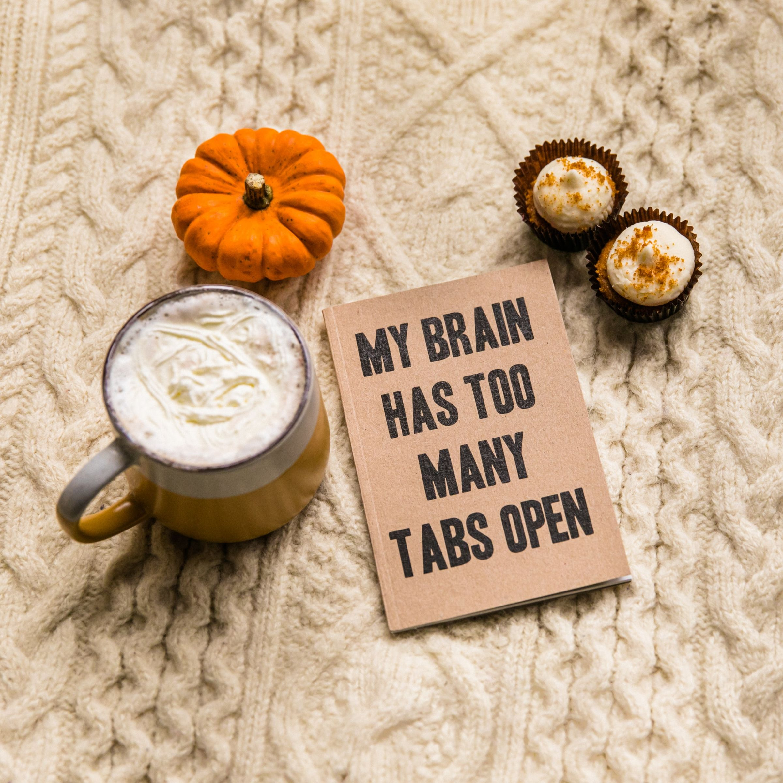
Neurolism
Neurolism lookes at the anatomy of the brain and its capacity to cope with complex human reactions such as intelligence, thinking and learning. An example is to imagine the brain as a computer, and the way it receives, processes and stores information.
back
main menu
exit
next
Notes:
Add note to this slide

Slide 53
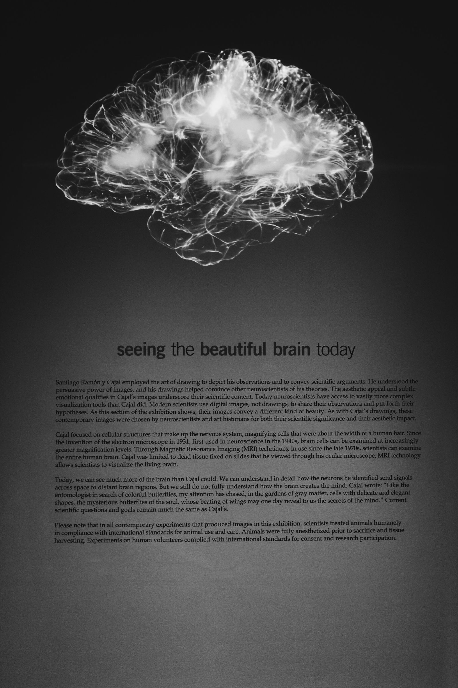
Which theory uses the example that people associate positive or negative experiences with an occurrence, which will shape their reaction in the future.
Select one:
a) Active Learning
b) Associative Learning
c) Adaptive Association Assumption
d) Auditory Learning
Neurolism
back
main menu
exit
next
Notes:
Add note to this slide

Slide 54
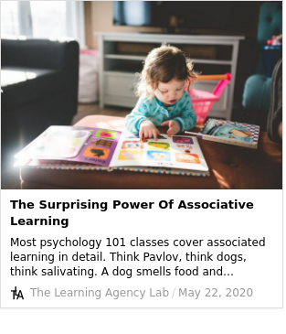
Corrtect!
Back
Next
Main
Exit
Notes:
Add note to this slide

Slide 55
Ooops!
Try again...
Back
Next
Main
Exit
Notes:
Add note to this slide

Slide 56
What does Cognitive Load Theory suggest?
Select one:
a) Working memory is vast and has virtually endless amounts of storage for new information.
b) Working memory can only hold between five and nine items (or chunks) of information at any one time.
c) A person cannot do more than one thing at a time.
d) People have a verbal code and a non-verbal code for learning.
Neurolism
back
main menu
exit
next
Notes:
Add note to this slide

Slide 57
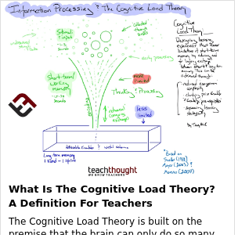
Corrtect!
Back
Next
Main
Exit
Notes:
Add note to this slide

Slide 58
Ooops!
Try again...
Back
Next
Main
Exit
Notes:
Add note to this slide

Slide 59
Which theorist developed the Dual Coding Theory?
Select one:
a) William Clinton
b) Allan Paivio
c) Leon Festinger
d) Bruno Mars
Neurolism
back
main menu
exit
next
Notes:
Add note to this slide

Slide 60
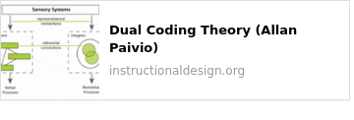
Corrtect!
Back
Next
Main
Exit
Notes:
Add note to this slide

Slide 61
Ooops!
Try again...
Back
Next
Main
Exit
Notes:
Add note to this slide

Slide 62
Which theory suggests that people have mental discomfort when they hold two conflicting beliefs, values, or attitudes?
Select one:
a) Borderline Distortion
b) Duality in Conflict
c) Cognitive Dissonance
d) Cognition Emergence
Neurolism
back
main menu
exit
next
Notes:
Add note to this slide

Slide 63
Corrtect!
Back
Next
Main
Exit
Notes:
Add note to this slide

Slide 64
Ooops!
Try again...
Back
Next
Main
Exit
Notes:
Add note to this slide

Slide 65
What does Donald Broadbent's theory of Artificial Intelligence suggest?
Select one:
a) Learning through computers is too difficult for 90% of the population.
b) The brain has a limited capacity to deal with a high number of stimuli, and therefore limited capacity & only a few move to the brain's memory banks.
c) When a person's memory banks are full, learning ceases.
d) The brain is like a computer and can store vast amounts of information for quick and easy access at a later time.
Neurolism
back
main menu
exit
next
Notes:
Add note to this slide

Slide 66
Corrtect!
Back
Next
Main
Exit
Notes:
Add note to this slide

Slide 67
Ooops!
Try again...
Back
Next
Main
Exit
Notes:
Add note to this slide

Slide 68
Well done!
Thanks 'fur' playing
Notes:
Add note to this slide

Slide 69
Thanks for visiting!
You may close your browser
Back to Start
Notes:
Add note to this slide

